Slide 1
Math Student Data Challenge
Apoorva Jadhav
Graduate Student
University of Connecticut

Slide 2
Approaches
Models Built
Excel Optimization
Random Forest Regressor
Linear Regression
Gradient Boosting Regressor
Tree-based Models

Slide 3
Approach: Excel Optimization using Analytic Solver
A relationship between the various decision variables and the Target variable needs to be established before performing optimization
In order to find that relationship, the simplest model that we considered was Linear regression

Slide 4
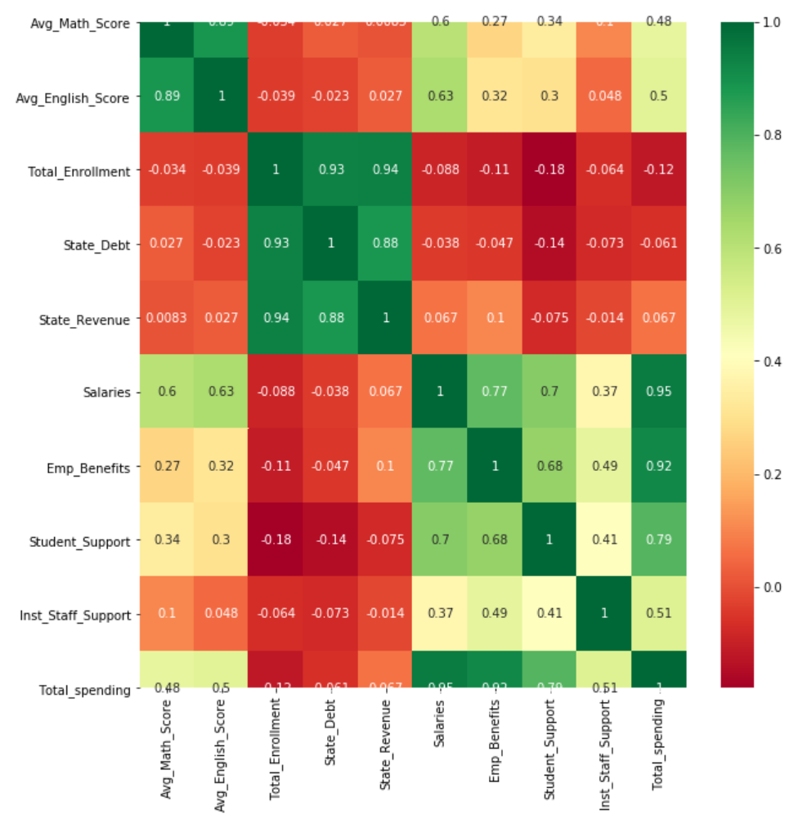
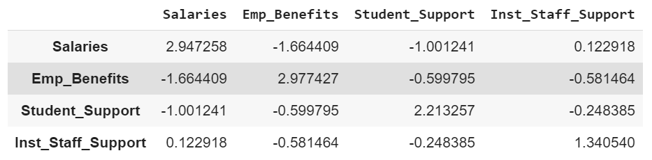
Approach: Linear Regression
Heat Map
Observed Multicollinearity between the predictor variables through:
Heat Map
VIF Score Estimation
Instability of coefficients
Little or no Multicollinearity is one of the key assumptions for building a Linear Regression model
VIF Score Estimation

Slide 5
Approach: Tree-based Models
Decision trees
Decision trees suffer when features are correlated
Since they choose a single feature instead of a combination of features to maximize information gain
This makes them unstable to small perturbations in the dataset
Random Forest
Ensemble models such as Random Forests exploit the instability created by multicollinearity
Since Random Forests choose a random subset of features to maximize information gain

Slide 6
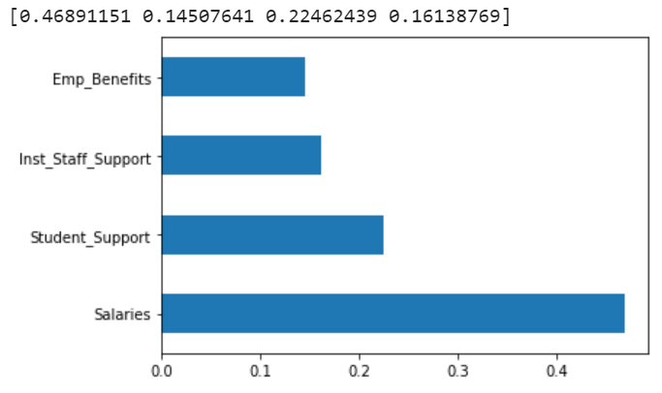
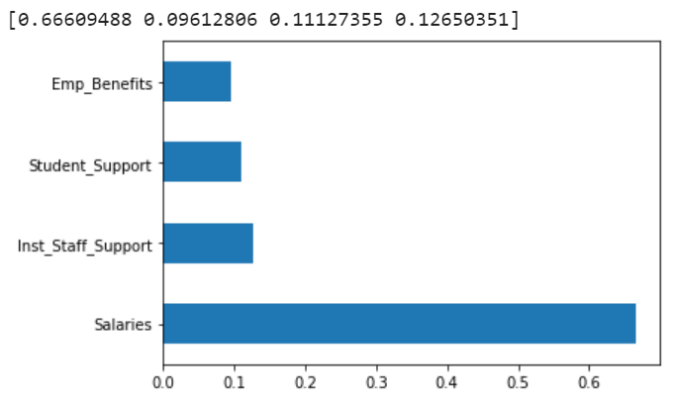
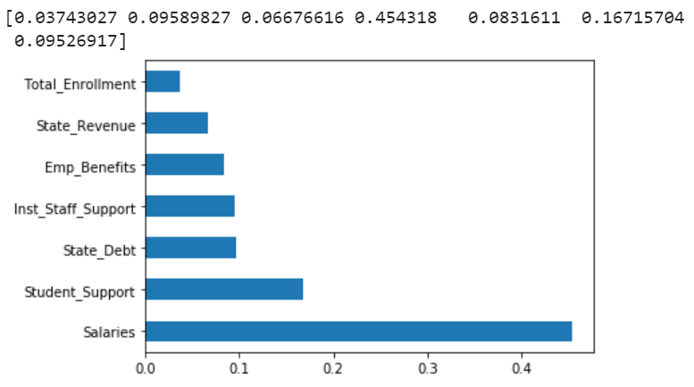
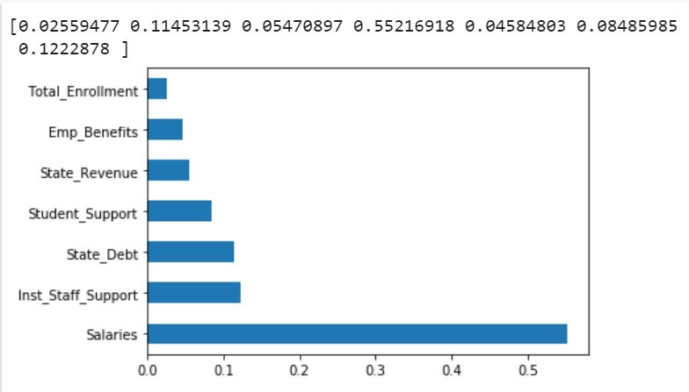
Feature Weights
Random Forest Regressor
Gradient Boosting Regressor
Notes:
Variable importance refers to how much a given model "uses" that variable to make accurate predictions.

Slide 7
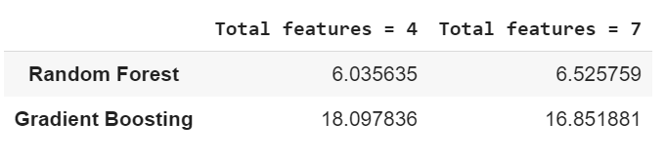
Model Selection
Random Forest Regressor with 4 Features
Random Forest model performed better than Gradient Boosting model in terms of mean squared error
The error was slightly lower when only four features (Salaries, Employee Benefits, Student Support, Institutional Support) were selected for modeling
Notes:
GB requires tuning that might lead to better performance
RF perform better on smaller data set than GB
RF performs better when there are few features to learn from

Slide 8
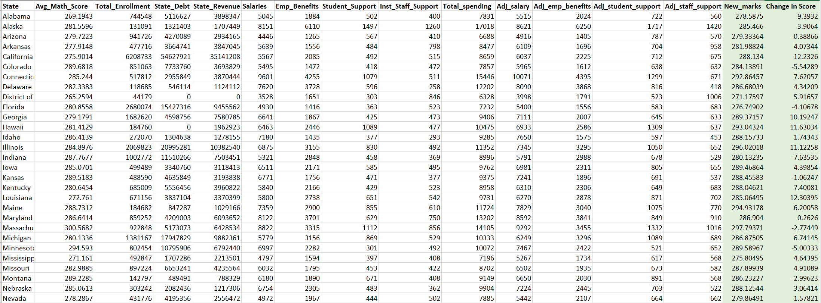
Model Results

Slide 9
Model Insights
Math Scores will see most improvement when the extra $1000 per student is divided as follows:
Salaries (46%)
Employee Benefits (14%)
Student Support (22%)
Institutional Support (16%)
The model improved math score by an average of 5.86 points for around 60% of the states
The importance of Salaries feature was found to be disproportionately greater than the other features in all the models
The recommended weightage affected the math scores negatively after increased spending for 20 states. This could be due to the effect of other parameters that are not considered in this model

Slide 10
Future Scope
With more data, the model can be trained better and issue of possible overfitting can be negated
Each State’s capacity to fund the additional $1000 per student can be considered to increase the applicability of the model

